Slide 1
NIPO GmbH presents Terrasolid® Ion Additive for Soil Stabilization for Using of Existing soils in road construction

Slide 2
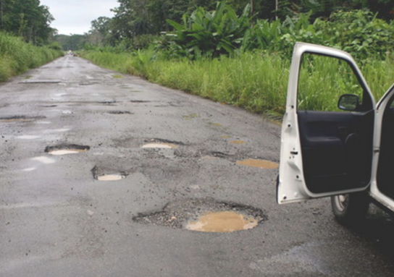
Terrasolid®
The Situation
Water is the enemy of roads worldwide.
Under dynamic traffic loads, water penetrates due to his capillarity from the underground into the subbase and base.
Overloading is boosting the effect.
The subbase / base collapse.
Settlements and potholes are the results.

Slide 3
Terrasolid®
What do we need?
A road, resistant to water influences.
Tolerant to overloads, flexible base and subbase.
Reusing of existing cohesive soils, instead of expensive granular base materials.
Complying to international standards: AASTHO, BS, EU-DIN, ZTV’s, for soil stabilization
Eligible by multilateral development banks (MDB).
A economical alternative, up to 70% lower traditional construction costs.

Slide 4

Terrasolid®
Fantasy ?
No.
We developed a soil additive for the soil consolidation with cement for the “Mixed in Place” method.

Slide 5

Terrasolid®
Method of Soil Stabilisation “Mixed in Place”

Slide 6
Terrasolid®
What is Terrasolid ?
Terrasolid is a harmless and a high concentrated active ionic liquid for stabilizing cohesive soils.
How Terrasolid works: By breaking the absorption water jacket and additional cation exchange of the soil particles, a higher proctor density will achieved.
Cement can be reduced to a minimum, savings to 60% of the cement contents.
After hydration, crystallization together with hydraulic binders, only a 15cm base course layer is recommended for paved roads.
Terrasolid is added to the milling process with 1:175 with water to the optimum Proctor moister content of soil (by considering the existing moisture content)
Terrasolid is protected by the Germany Patent Office in Munich

Slide 7
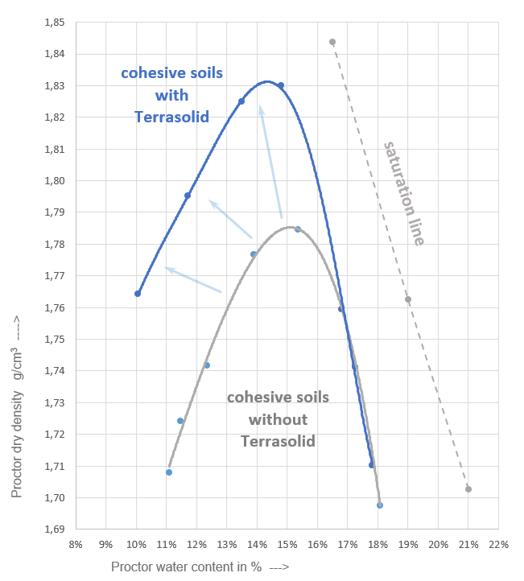
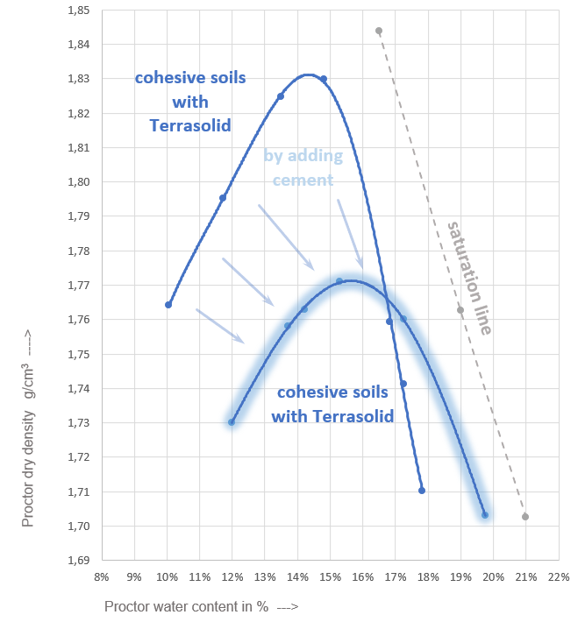
Terrasolid®
How it works? - optimising the Proctor density.

Slide 8
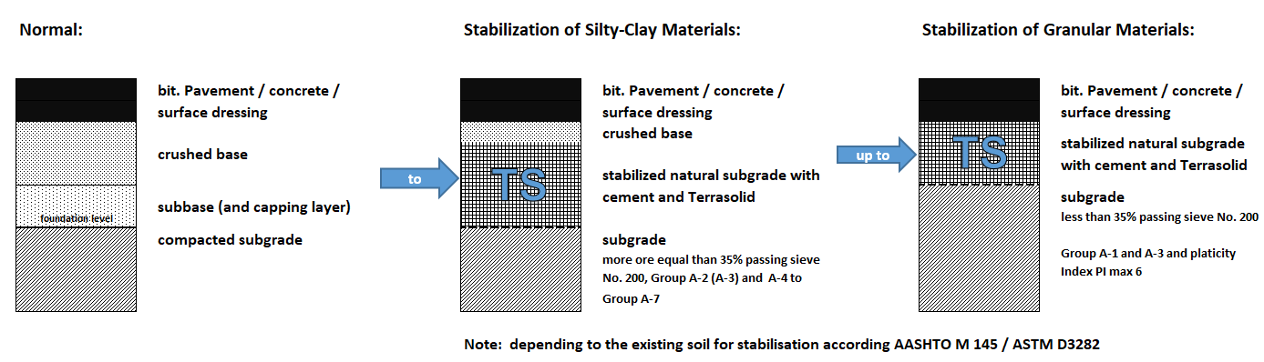
Terrasolid®
Our Target: SAVING OF BASE AND SUBBASE LAYERS

Slide 9
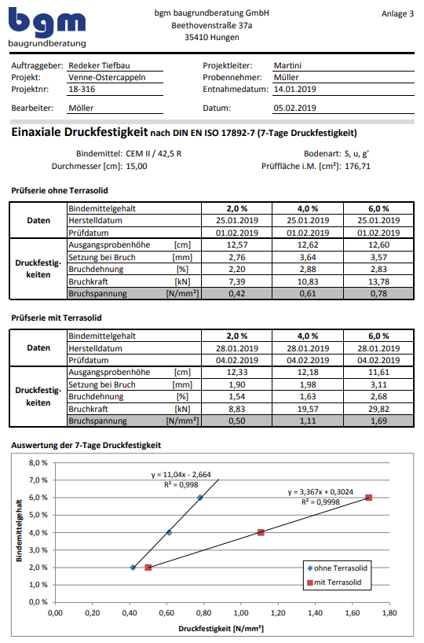
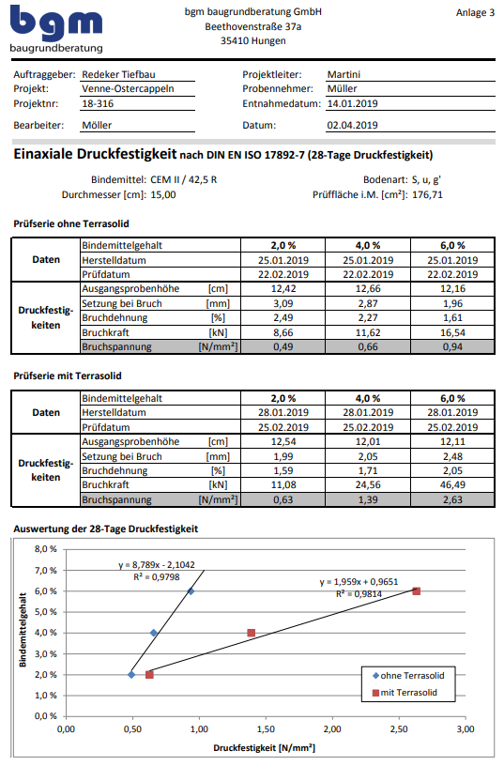
Terrasolid®
The results:
saving of more than 60% cement under the same conditions by using Terrasolid:
- after 7 days 62% cem savings
- after 28 days 70 % cem savings
and it will get more stronger………..

Slide 10
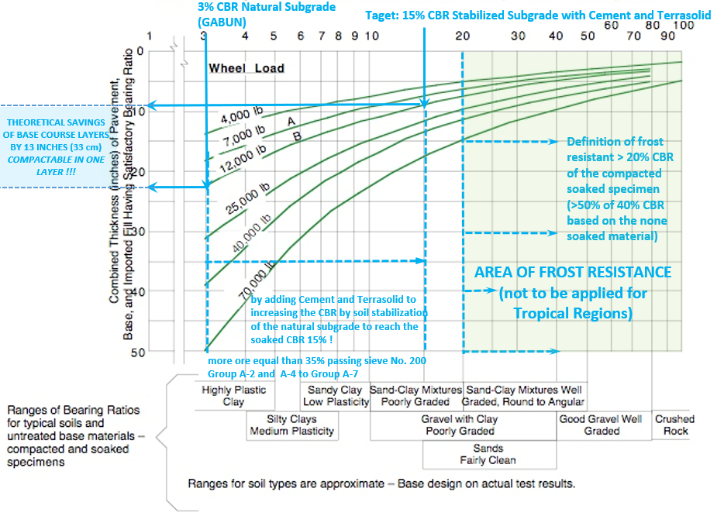
Terrasolid®
12,000 lb ~ axle load 11 t
Pavement Design:
Determination the thickness of Pavement acc. to the California Bearing Ratio of the Subgrade, under soaked condition

Slide 11
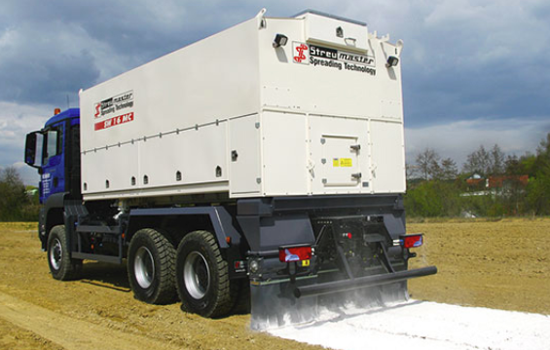
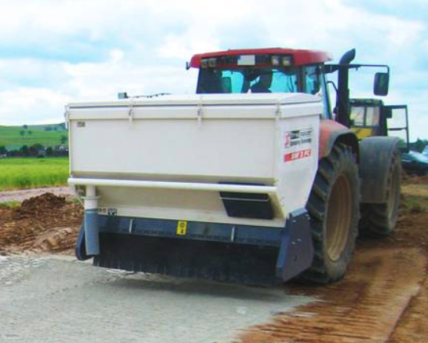
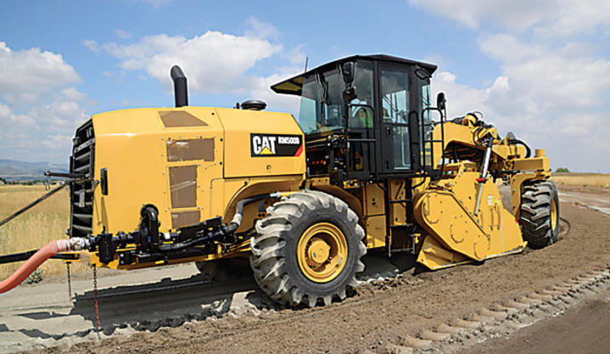
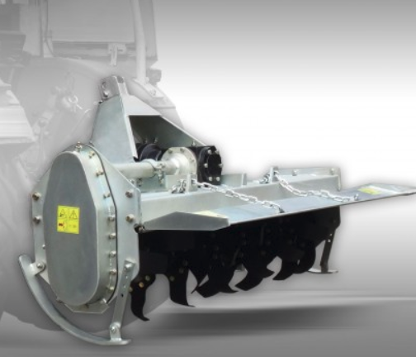
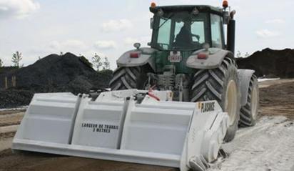
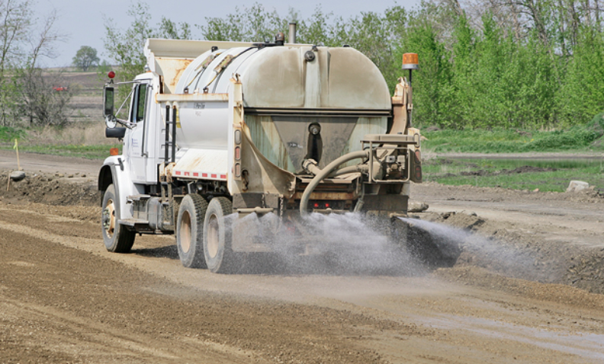
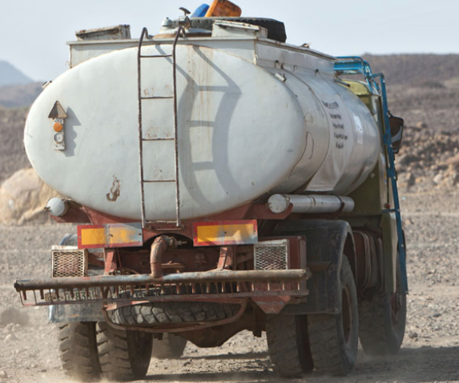
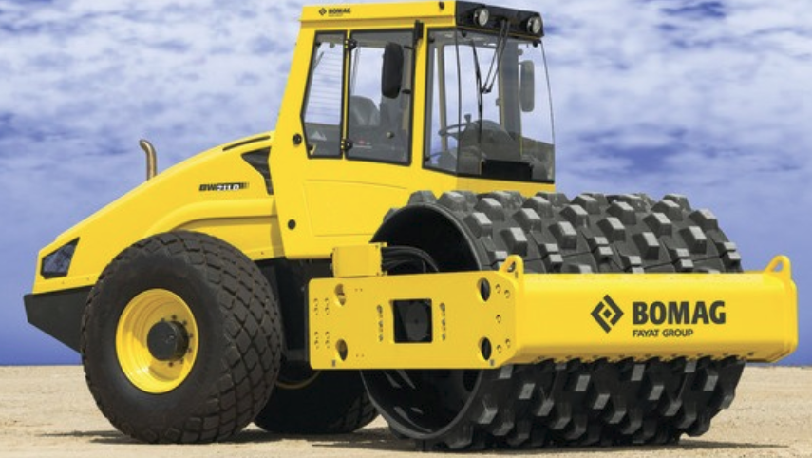
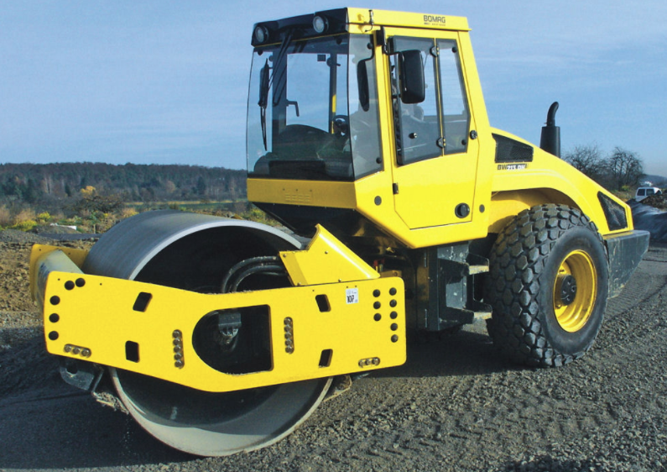
Terrasolid®
Equipment needed:
Cement Spreader:
Soil Stabilizer or Soil Millers:
Water Distributor Truck:
Rollers:

Slide 12
Terrasolid®
Advantages
Natural resources savings, due to stabilising existing soil up to base criterias.
Less hydraulic binder, compared to the traditional soil stabilisation.
No additional capping layers required.
Low traffic roads can be built even without granular base material.
Increase the traffic safety due to lower side ditches.
No compaction of natural soil under soil stabilisation required.
Reducing maintenance costs with longer live time.
Economical, starting from 1.8 $/m³ for the additive and 75kg/m³ cement against 175 kg/m³ with saving of 100 kg cement. Savings of 10 $/m³ against common soil stabilization and more than 40 $/m³ against crushed rock.
Easy laboratory testing in advance for soil stabilization according to the applicable standards of the country.

Slide 13

Terrasolid®
More detailed Information:
www.terrasolid.de
info@terrasolid.de
NIPO Vertriebsgesellschaft mbH
Buchholz1
49492 Westerkappeln (Germany)

Slide 14
Terrasolid®
Thanks

